Slide 1

The European Research Council
ERC Grants: overview of 2025 calls
Martin Penny
© Art & Build Architect / Montois Partners / credits: S. Brison

Slide 2


ERC is part of Horizon Europe
EUR 16 billion
ERC budget in Horizon Europe
17%
of the entire
Horizon Europe budget

Slide 3


ERC basics

Slide 4



Individual grants
Starting Grants
2-7 years after PhD
up to €1.5 M
for 5 years
Consolidator Grants
7-12 years after PhD
up to €2 M
for 5 years
Advanced Grants
track-record of significant
research achievements
up to €2.5 M
for 5 years

Slide 5


Other grants
Synergy Grants
2 – 4 Principal Investigators
up to €10.0 M for 6 years
1 PI can be based outside EU/Associated Countries
Proof-of-Concept
bridging gap between research - earliest stage of marketable innovation
lump sum €150,000 for 1.5 years
for ERC grant holders

Slide 6
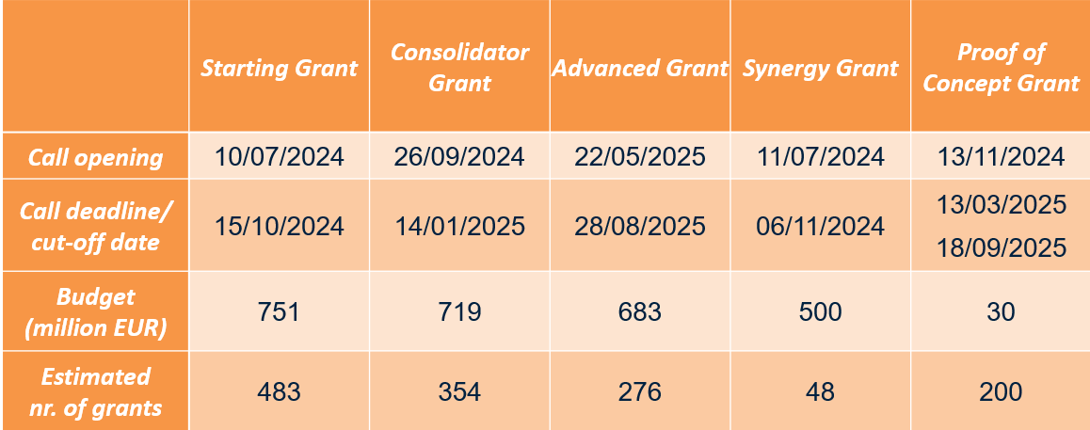
ERC Work Programme 2025:
Provisional Call Calendar

Slide 7
Where can you find more information?
ERC website
ERC National Contact Points: your first point of contact
EU Funding & Tenders Portal: ERC calls are published in this portal
Research Enquiry Service (europa.eu): for questions regarding Horizon Europe, funding instruments available and validation process of participants

Slide 8
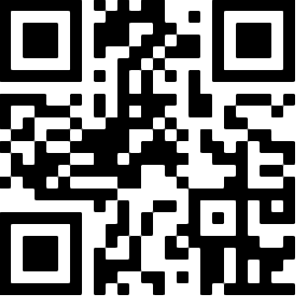






Thank You!
More information: erc.europa.eu
Follow us on social media
@ERC_Research
@ERC_Research
European-Research-Council
European Research Council
European Research Council - ERC
European Research Council

