Slide 1

The European Research Council
Guidance on Research Ethics requirements
Nicole Heine
© Art & Build Architect / Montois Partners / credits: S. Brison

Slide 2

Overview
    Ethics process in Horizon Europe – key aspects
    Ethics in your application – information to include
    Serious and Complex ethics issues
    Ethics appraisal process
    Practical information
Ethics
Your application
Serious and complex?
Ethics appraisal
Practical information

Slide 3
Ethics process in Horizon Europe – key aspect:
Why it matters
To ensure that each ERC grants respect EU ethics principles in research
To respect legal obligations
  HE Framework Programme - Regulation 2021/695: Eligible actions and ethical principles (Article 18) and Ethics (Article 19)
To support researchers handling ethics aspects of their proposals

Slide 4
Ethics process in Horizon Europe – Key aspects: responsibility and trust
Responsibility and Trust
  Responsibility for ethics lies with the ones performing the research, the researchers
  Accountability lies with the signatory of the Grant Agreement, the Host Institution (Host Institution)
  Trust in researchers and HI to comply with ethics principles, Union, national and international law

Slide 5
Ethics process in Horizon Europe – Key aspects
Proposals involving serious and Complex ethics issues
  Guidelines
      Identifying serious and complex ethics issues in EU-funded research
  Undergo an ethics assessment
  Pending ethics requirements become contractual obligations as part of the grant agreement

Slide 6
Ethics process in Horizon Europe – Key aspects
Serious and Complex ethics issues
  Potential to violate fundamental rights or freedoms
  Potential to result in significant harm
  Particularly complicated methods or technologies that have not been sufficiently tested and give rise to uncertainty
  Raise significant ethics issues ‘at scale’
  Raise multiple or ‘intersectional’ ethics issues

Slide 7
Ethics in your application – information to include
  Guidelines
  How to complete your ethics self-assessment
  Ethics Issues table
  Ethics self-assessment (Part A)
  i) Ethical dimension of the objectives, methodology and likely impact
  ii) Compliance with ethical principles and relevant legislation
  Annexes can be included (approvals, authorizations,…)

Slide 8
Ethics in your application – information to include in the EIT (Ethics Issues Table)
1. Human embryonic stem cells (hESCs) & human embryos
2. Research involving humans
3. Human cells or tissues
4. Personal data
5. Animals
6. Non-EU countries
7. Environment, health and safety
8. Artificial intelligence
9. Other ethics issues
Crosscutting issue: potential misuse of results

Slide 9



Serious and/or complex ethics issues - Examples
Human Embryonic Stem Cells and Human Embryos
              Scientific Evaluators to confirm necessity to use hESC
          Programme Committee vote and EC decisions
          HI’s past experience
Human participants
              Medical/invasive studies
              Experiments with vulnerable individuals such as certain patients, prisoners and/or children
Personal data
              Special categories of personal data – minimisation principle
              Unclear roles and data processing techniques under GDPR
              Consult with the HI’s Data Protection Officer

Slide 10
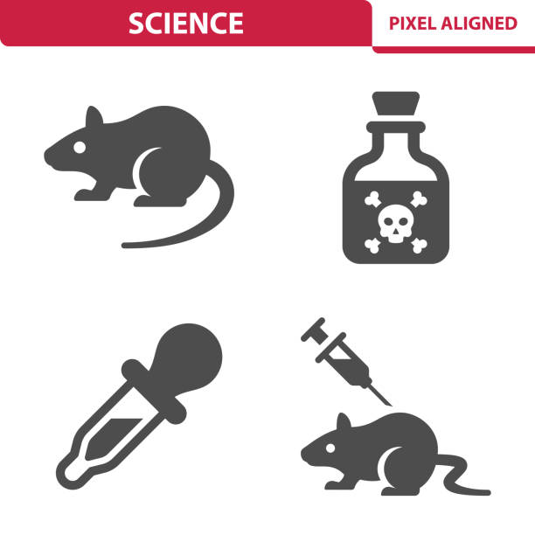


Serious and/or complex ethics issues - Examples
Animals
              Severity of the experiments
          Work with Non-human primates
          Ethics committee/Institutional review Board
Non-EU countries
              Ethics dumping
              Dangerous settings
Artificial Intelligence
              Influence on human decision
              Profiling and bias

Slide 11
Ethics appraisal procedure
End of scientific evaluation
Signature Grant Agreement
Ethics tables & annexes, Parts B
70%
3 weeks
Ethics pre-screening
Clearance with or
without Keep on file
Ethics screening
15%
7 weeks
Clearance with Keep on file
and/or Ethics advisor or board
Ask information to the PI
Ethics assessment
Clearance with deliverables
and/or Ethics advisor or board
13%
3 months
New documentation from PI
2%
2-4 months
hESCs submitted to Programme Committee + EC for decision

Slide 12




Ethics appraisal procedure – Review (Assessment)
Assessment for proposals with Serious and/or Complex ethics issues
A hybrid approach for complex ethics in ERC research grants
  Keep on File documents for non-Complex/Serious ethics issues
  Requirements for Serious and/or Complex ethics issues
Pending ethics requirements become deliverables
May also include Ethics Advisor/Board and/or Ethics Review after the start
of the grant (also possible for Screening)
PI-HI
Collaboration

Slide 13
Practical information – useful links
Guidelines on identifying serious and complex ethics issues in EU-funded research
https://ec.europa.eu/info/funding-tenders/opportunities/docs/2021-2027/horizon/guidance/guidelines-on-serious-and-complex-cases_he_en.pdf
Horizon Europe Programme Guide
https://ec.europa.eu/info/funding-tenders/opportunities/docs/2021-2027/horizon/guidance/programme-guide_horizon_en.pdf
ERC Website – Managing your projects – Ethics
https://erc.europa.eu/managing-your-project/ethics

Slide 14
Practical information – useful documents
Guidance note on potential misuse of research results
Guidance note on research focusing exclusively on civil applications
Guidance note on research on refugees, asylum seekers and migrants
Ethics and data protection
Ethics in Social Science and Humanities
Position of the European Network of Research Ethics Committees (EUREC) on the Responsibility of Research Ethics Committees during the COVID-19 Pandemic
Functional Magnetic Resonance Imaging
Research Ethics in Ethnography/Anthropology
Roles and Functions of Ethics Advisors/Ethics Advisory Boards in EC-funded Projects
SIENNA Ethical guidance for research with a potential for human enhancement
Guidelines on ethics by design/operational use for Artificial Intelligence
Guidance on Information Requirements and Chemical Safety Assessment
Global Code of Conduct for Research in Resource-Poor Settings

Slide 15







Thank You!
More information: erc.europa.eu
Follow us on social media
@ERC_Research
@ERC_Research
European-Research-Council
European Research Council
European Research Council - ERC
European Research Council

