Slide 1

The European Research Council
Preparing your proposal
Ino Agrafioti & Jana Sifta
© Art & Build Architect / Montois Partners / credits: S. Brison

Slide 2

First things first: get information (early on)!
Get familiar with the European Commission's Funding and Tender portal and download the templates
https://ec.europa.eu/info/funding-tenders/opportunities/portal/screen/home
Call documents (Information for Applicants, Work Programme, Frequently Asked Questions) explain how to prepare your proposal
Ask your questions
  NCPs
  Host Institutions’ grant offices
  ERC grantees
  ERCEA e.g., ERC-2024-ADG-APPLICANTS@ec.europa.eu , ERC-2025-COG-APPLICANTS@ec.europa.eu
Notes:
7/10/2024
2

Slide 3

Physical Sciences & Engineering
PE1 Mathematics
PE2 Fundamental Constituents of Matter
PE3 Condensed Matter Physics
PE4 Physical and Analytical Chemical Sciences
PE5 Synthetic Chemistry and Materials
PE6 Computer Science and Informatics
PE7 Systems and Communication Engineering
PE8 Products and Process Engineering
PE9 Universe Sciences
PE10 Earth System Science
PE11 Materials Engineering
Step 2: choose your Panel
Evaluation Panel Structure 2024
Life Sciences
LS1 Molecules of Life: Biological Mechanisms, Structures and Functions
LS2 Integrative Biology: From Genes and Genomes to Systems
LS3 Cell Biology, Development, Stem Cells and Regeneration
LS4 Physiology in Health, Disease and Ageing
LS5 Neuroscience and Disorders of the Nervous System
LS6 Immunity, Infection and Immunotherapy
LS7 Prevention, Diagnosis and Treatment of Human Diseases
LS8 Environmental Biology, Ecology and Evolution
LS9 Biotechnology and Biosystems Engineering
Social Sciences and Humanities
SH1 Individuals, Markets and Organisations
SH2 Institutions, Governance and Legal Systems
SH3 The Social World and Its Interactions
SH4 The Human Mind and Its Complexity
SH5 Texts and Concepts
SH6 The Study of the Human Past
SH7 Human Mobility, Environment, and Space
SH8 Studies of Cultures and Arts

Slide 4

Choosing the right Panel is very important!
Proposals are initially assigned to the Panel of the PI's choice.
The PI can flag one “Secondary Review Panel” → the PI must explain the interdisciplinary nature of the proposal in the special section in the first page of Part B1.
Transfer of proposals between panels may occur if:
  there is a clear mistake on part of the applicant.
  the necessary expertise is available in a different panel.
Both Panel Chairs must agree on the transfer!
Rumour: The panel descriptors represent ERC scientific priorities
NOT true: The panel descriptors are indicative so that PIs can see what expertise is in the Panel. It is the PIs that choose the subject of their proposal and the Panels use the excellence criterion to judge whether it should be funded.
Rumour: Choose the panel "strategically” in order to increase chances of success
NOT true: Choose the panel that best fits the proposal. The budget is distributed among the scientific panels as a function of demand → success rate is equal amongst panels!

Slide 5

Step 3: Start writing …
PART A – admin forms online
Section 1 Proposal and PI info
Section 2 Host Institution info
Section 3 Budget
Section 4 Ethics
Section 5 Call-specific Questions
PART B1 – submitted as .pdf
  Abstract and Cross-Panel explanation 1 p.
  Extended Synopsis 5 p.
  CV & Track Record up to 4 p.
Seen by the panel
Annexes – submitted as .pdf
Statement of support of HI
copy of PhD or equiv. (StG & CoG)
If applicable:
document for extension of eligibility
window (StG & CoG)
explanatory info on ethical issues
PART B2 – submitted as .pdf
  Scientific Proposal 14 p.
  Funding ID 1 p.
Notes:
10/08/12
5

Slide 6

Choose your descriptors and free keywords carefully in Part A!
Descriptors and free keywords
influence which Panel will evaluate your proposal
are the basis of allocation to the panel members
will determine whether a cross-panel evaluation is necessary
Rumour: The more cross-panel descriptors I indicate, the higher the funding chances, since I emphasize like this the interdisciplinarity of my proposal.
NOT true: even though these are used to allocate proposals to Panel Members, once the proposals are allocated, the Panel Members do not see the keywords and descriptors used.

Slide 7
CV and Track Record
No prescriptive Principal Investigator profiles
Instead, 3 sections
Personal Details
PI’s education and key qualifications, current position(s) and relevant previous positions they have held.
  Research achievements (<=10) and Peer Recognition
      demonstrating advancement in the field, with emphasis on more recent achievements
      prizes, fellowships, academy membership, etc.
      The applicant can provide a short, factual narrative on the significance of the listed achievements and recognitions in relation to the research field and the proposed project.
  Additional Information
  Relevant additional information on their research career to provide context when assessing their research achievements and peer recognition.
    career breaks, diverse career paths, life events
    other noteworthy contributions to research community

Slide 8

When writing your CV and Track Record
Use the recommended template with the 3 sections as much as possible.
The CV/Track Record part of B1 is still very important, so do put time and effort in it.
Tell your story!
Explain what has been your own contribution to your publications/how they have impacted the field.
Convince the panel that you are the forefront of your research field – this may be (very) different for different people so make sure you highlight your key strengths and accomplishments.
Are you internationally active? i.e. speaker in international conferences? Do you have any international collaborations? (mobility is not a criterion!)
Explain publishing habits in your field and country if needed.
Describe accurately any other activity that can indicate scientific maturity.
If you know that you have gaps or other issues in your CV, explain them in the Additional Information section.

Slide 9
When writing your CV and Track Record
Rumour 1: You can only apply for an ERC grant if you are a highly accomplished researchers.
NOT true: Accomplishments are appreciated in relation to your stage/seniority as giving some evidence of your capacity to conduct the research you propose and of creativity.
Rumour 2: One needs publications in Nature/Science/High IF journals to succeed.
NOT true: however, publishing with senior scientists (former supervisors) may raise doubts about maturity/scientific independence.
Rumour 3: One needs to say how many people they have supervised.
NOT true: The Scientific Council concluded that the supervision element becomes a proxy that is in part a reflection of the excellence of the environment rather than the research team leader.
Rumour 4: The quality/fame of the HI is increasing my chances/scores.
NOT true: the HI is not an evaluation criterion!

Slide 10

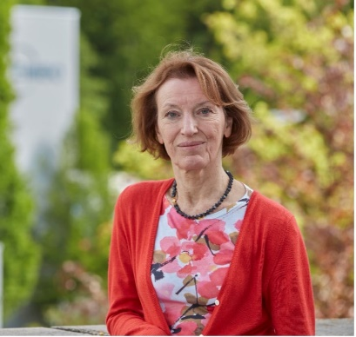
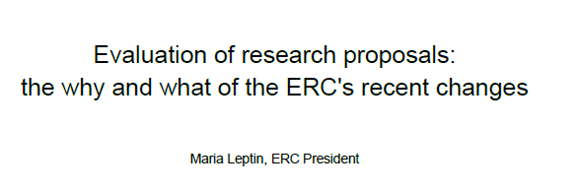
CV and Track Record
https://erc.europa.eu/news-events/news/evaluation-research-proposals-why-and-what-ercs-recent-changes

Slide 11

Research Project
Streamlined evaluation questions
No explicit reference to ‘high-risk/high-gain’
  Instead: ‘ground-breaking, ambitious, and feasible’.
  The ERC will always encourage risky research.
No explicit reference to ‘novel methodologies’
  ‘Novel methodologies’ is an element that may be positive but is not strictly necessary for an excellent proposal.

Slide 12

Part B1 is all about finding the right balance
Step 1 discussions are based on remote assessment of Part B1 – consisting of the Synopsis and Track Record/CV - by Panel members only. They are asked to look at FEASIBILITY.
Part B1 gives the first impression of your project/yourself.
Part B1 will determine if you pass to Step 2.
Part B1 is a synopsis of the project so it should include all main elements.
Use full space available (5 pages)

Slide 13

Questions to ask yourself (1)
Is my project new, innovative, bringing in new solutions/theories?
Does it promise to go substantially beyond the state of the art? Something significant, that will last, not just something that will be improved in 5 years (one major step better then several small steps). Think Big! Make sure that your idea needs an ERC to do it!
Why is my project important? Answering a complete question (not only ‘what’ but also ‘why’)
Is it timely? (Why wasn't it done in the past?)

Slide 14
Questions to ask yourself (2)
How can I prove/support my case? Do I have a hypothesis? Do I have supporting evidence? Have I proven the project's feasibility? Are my goals realistic?
What's the risk? Is it justified by a substantial potential gain? Do I have a plan for managing the risk? Make sure that your risk is not too early on in the project. Do and redo the structure of the WPs* until you are fully convinced. Have I proposed alternatives?
Why am I the best/only person to carry it out? Know your competitors – what is the state of play, and why is your idea and scientific approach outstanding compared to them?
Have I given a realistic picture of my collaborations? Show that you can drive the collaborations but that it is you who will be leading the project.
Attention: Get written consent of your collaborators before the submission deadline (a simple email is OK)

Slide 15
Some more rumours…
Rumour 1: I need preliminary results.
NOT true: You do not, however you need to explain how the literature supports your hypothesis.
Rumour 2: To be successful, you need to continue an established research line, to prove continuity and credibility
NOT true: Generally, the opposite is true.
Rumour 3: If you have already obtained on ERC grant you are less/more likely to get another one.
NOT true: Panels look at each proposal on its own merit and in comparison with the other applications, irrespectively of whether you have or have not obtained an ERC grant in the past. (Of course this does not apply for applications to a Proof of Concept grant.)
Rumour 4: The more socially or medically relevant a proposal is, the higher the chances of it getting funded.
NOT true: ERC funds frontier research, not research that promises to be only an incremental advancement of knowledge. This is irrespective of the field and whether it has societal, medical or clinical applications.

Slide 16
Part B2 is for filling in the details
Step 2 interview and discussions are based on remote assessment of both Parts B1/B2 by Panel members AND external reviewers. In Step 2, they are asked to look at METHODOLOGY.
Do not repeat the synopsis: go instead into details on your methodology and work plan! (Panel Members remember the Part B1 they read at step 1 and external reviewers read both B1/B2 consecutively.)
Make sure that there is an obvious link between B1 and B2.
Further explain your hypothesis and/or provide supporting evidence (if it exists)
Show you did your homework!
  Make sure that the quantitative and qualitative differences to the state-of-the-art are clear and referenced
  Make sure that that literature summary is as complete as possible
Provide more information on the alternative strategies to mitigate the risks.

Slide 17
Part B2 is for filling in the details
Describe some sort of timeline
Think the project as a team - explain involvement of team members and collaborators (be careful though: ERC proposals are NOT consortium proposals)
Use full space available (14 p.)
Make sure you give full references (these are excluded from page count so there is no excuse)
Fill in your Funding ID fully.

Slide 18

Respect the reader so that the reader can respect you
Make the project "easy to read and attractive"
Use paragraphs and correct typos
Do not submit a document with track changes
Avoid jargon
No excessive highlighting
Do not oversell it
Check the coherence of figures/tables
Make sure that there are proper legends to figures/tables as well as that the figure axes are clearly visible

Slide 19

Explain properly your resources and budget
Budget analysis carried out in Step 2/Step 3 of the evaluation.
Panels have responsibility to ensure that resources requested are reasonable and well justified.
Budget cuts need to be justified on a proposal-by-proposal basis (no across-the-board cuts).
Costs are often cut when they have not been explained.
Panels do not “micro-manage” project finances.
Awards made on a “take-it-or-leave-it” basis: no negotiations.
Ask for funding for Open Access – this is obligatory in HorizonEurope!
Rumour 1: If I do not ask for a large sum, I have no chances- only complex and expensive projects get funded.
NOT true: There are many areas where it may make little or no sense to ask for the maximal amount of funds. No grant was ever rejected for asking too few funds.
Rumour 2: Ask for funding beyond the max, the panel will anyhow cut it down.
NOT true: unexplained or non-motivated requests can be cut down, so if you artificially inflate your budget, the extra funding will be indeed cut.

Slide 20
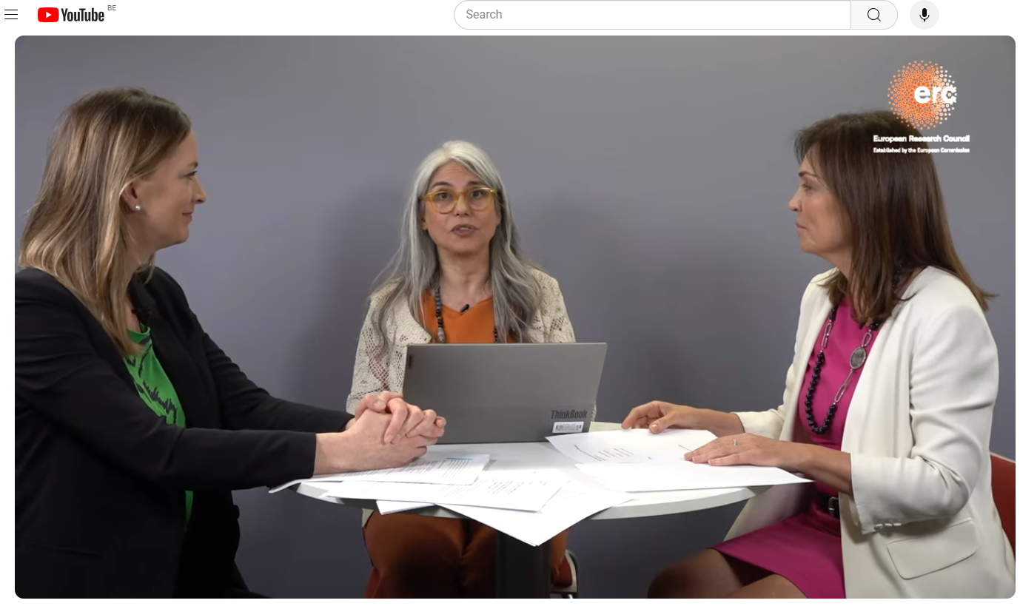
Pilot lump sum model for the Advanced Grant call 2024
https://www.youtube.com/live/oKhCdAavkMI?si=D3RMHgxAoBxYOzrS

Slide 21

Final step: submit!
A submitted proposal can be revised until the call deadline by submitting a new version and overwriting the previous one.
Once you submit, all you need to do is wait!
It's our turn to do the work!
Notes:
10/08/12
21

Slide 22

Typical reasons for rejection – a summary
Research Project
Scope: Too narrow ←→ too broad/unfocussed
Incremental research
Collaborative project, several PIs
Work plan not detailed enough/unclear
Insufficient risk management
Part B2 did not give sufficient information on the methodology
Principle Investigator
Insufficient track-record
You did not apply
If rejected, KEEP TRYING
Reapplications have a higher success rate
Use the feedback from evaluation reports
Notes:
10/08/12
22
09/16/12
22

Slide 23
Not leaving it to the last minute means that you could re-apply in the same call – success rates are flat
Rumour: I should wait until the end of the eligibility window in order to accumulate enough seniority: only then I will be competitive.
NOT true: The success rate is virtually flat across the eligibility window (StG, CoG).

Slide 24


