Slide 1
The European Research Council
The ERC evaluation process
David Gallego
© Art & Build Architect / Montois Partners / credits: S. Brison

Slide 2
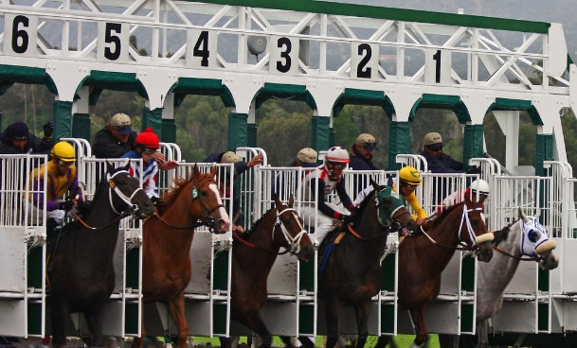
The ERC Evaluation process: 1 proposal, 2 steps.
Alea iacta est…
… our work starts here.
ELIGIBILITY
Stay tuned for requests!
Evaluation Starts!

Slide 3
Assign reviewers
Abstract + keywords
Conflict of Interest
Identified + declared + excluded reviewer
Individual Reviews
Panel Members + CPRs Generalist

Slide 4
Evaluation
Sole criterion : scientific excellence.
Evaluation primarily focused on the proposed research project: ground-breaking nature, ambition, and feasibility.
Principal Investigator: overall assessment of scientific capacity, creativity and expertise and capacity to execute the project.

Slide 5
Assign reviewers
Abstract + keywords
Conflict of Interest
Identified + declared + excluded reviewer
Individual Reviews
Panel Members + CPRs Generalist
Discussion
Ranking
Step 1 Panel Meeting
Reviews to ALL panel
Intellectual capacity and creativity
To what extent has the PI demonstrated the ability to conduct ground-breaking research?
To what extent does the PI provide evidence of creative and original thinking?
To what extent does the PI have the required scientific expertise and capacity to successfully execute the project?
Ground-breaking nature, ambition, and feasibility
To what extent does the proposed research address important challenges?
To what extent are the objectives ambitious and beyond the state of the art (e.g., novel concepts and approaches or development between or across disciplines)?
To what extent is the outlined scientific approach feasible bearing in mind the groundbreaking nature and ambition of the proposed research?
A invited max. 44
A not invited Can apply next year
B Wait for 1 year
C Wait for 2 years
Nominate Remote
Reviewers
Individual Reviews
Panel Members + Specialists RRs
Prepare your interview!
Feedback to Applicants

Slide 6
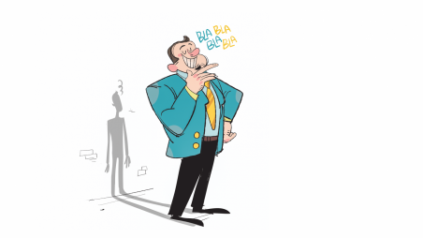
I have been invited for an interview – now what?
Avoid overselling
Anticipate questions
Focus on the Science
Practice, practice, practice
SCIENCE
https://www.tbsnews.net/features/pursuit/perils-overselling-yourself-283792
Don’t just read your presentation
Test yourself:
Mock interview
https://20x20.com/do-you-finally-need-reading-glasses/

Slide 7
Assign reviewers
Abstract + keywords
Conflict of Interest
Identified + declared + excluded reviewer
Individual Reviews
Panel Members + CPRs Generalist
Discussion
Ranking
Step 1 Panel Meeting
Reviews to ALL panel
Ground-breaking nature, ambition, and feasibility
To what extent does the proposed research address important challenges?
To what extent are the objectives ambitious and beyond the state of the art (e.g., novel concepts and approaches or development between or across disciplines)?
To what extent is the outlined scientific approach feasible bearing in mind the groundbreaking nature and ambition of the proposed research?
To what extent are the proposed research methodology and working arrangements appropriate to achieve the goals of the project?
To what extent are the proposed timescales, resources, and PI commitment adequate and properly justified?
A invited max. 44
Individual Reviews
Panel Members + Specialists RRs
Interview
Discussion
Ranking
Nominate Remote
Reviewers
Step 2
Panel Meeting
Prepare your interview!
A Funded
A Not funded
B No submission
restriction
Budget checks
and approval
Feedback to Applicants

Slide 8
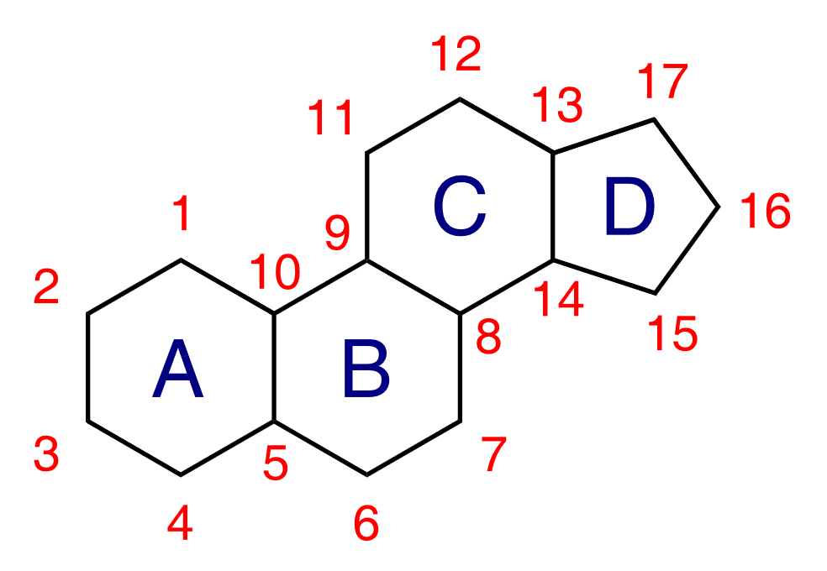
Myths and Mistakes
1. English native speakers have a clear advantage
2. Projects with acronym starting by A have better chances to get funded
3. Interviews scheduled for late afternoon
(or late in the week) are less successful.
1. Unsure/unconvincing about your own project.
2. Provide vague/unnecessary long answers.
https://www.linkedin.com/pulse/stop-wasting-your-time-boring-unproductive-meetings-mac-mcintire/
3. Unaware of or “hiding” recent development in the field.

