Slide 1
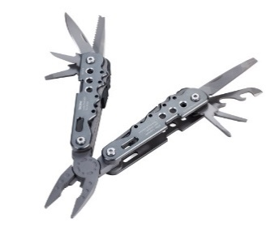
Thorsten Stafforst – RNA-based technologies
Site-directed RNA base editing – A marketable innovation
Chemistry + Bioengineering
Tools
Drugs
that target RNA
EIC – ERC Workshop Gene and Cell Therapy – June 2021

Slide 2
Thorsten Stafforst – RNA-based technologies
Site-directed RNA base editing
Chemistry + Bioengineering
ACIE 2012
Nat. Meth. 2018
Science 2017
Tools
Drugs
that target RNA

Slide 3
Thorsten Stafforst – RNA-based technologies
Site-directed RNA base editing
Chemistry + Bioengineering
ACIE 2012
Nat. Meth. 2018
Science 2017
Tools
Drugs
RESTORE
◦ chem. mod. ASO
◦ harness endog. ADAR
◦ highly precise A-to-I
◦ novel drug platform
◦ dosable, reversible
→ safer, patient compliance (?)
that target RNA
Stafforst Nat. Biotech. 2019

Slide 4
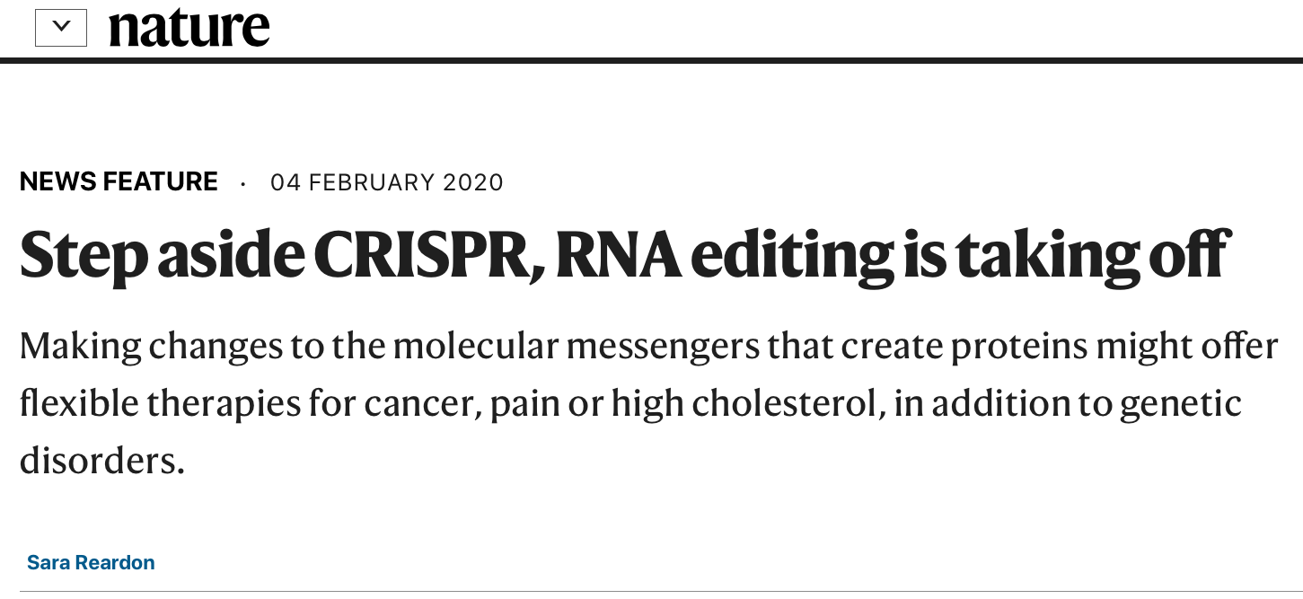
Thorsten Stafforst – RNA-based technologies
The promise of therapeutic RNA base editing

Slide 5
Thorsten Stafforst – RNA-based technologies
The promise of therapeutic RNA base editing
DNA editing
RNA therapy
+ Versatile editing capability
– Unmet safety issues
+ Clinically proven concept
– No editing capability
CRISPR
siRNA, ASO
(mRNA)
RNA editing
+ Editing capability
+ Promising safety profile

Slide 6
Thorsten Stafforst – RNA-based technologies
Bottlenecks Knowledge → Innovation (EU)
Investors
◦ don´t stay in US come to EU
◦ make use of ideas and heads
◦ talk to academics early
◦ fund novel ideas early (Incubator)
(Young) Academic Researcher
◦ lacking experience
◦ approach investor – when&how?
◦ start-up – when&how?
◦ patent or publish?
EU
◦ yearly seed funding program (2-3 Mio EUR/project)
Processes at Academic Institutions
◦ slow patenting
◦ no patenting strategy
◦ little reward for patents/IP
◦ little interest in translation
◦ e.g. consulting, sponsored research,
licensing, lab space → CoI discussion
◦ almost no Incubators for Biotech
Academic System (Paper, Grants, Positions)
◦ teaching/administrative burden
◦ Grants & PhD project (low risk – fast gain)
too short-termed (3y)
too structured
◦ high publ. frequency expected
◦ fashionable vs. sustained/novel directions

