Slide 1
Research Internationalisation, Mobility and the ERC
10 November 2020
Eloïse A Marais
http://maraisresearchgroup.co.uk/

Slide 2
My motivation to be in Europe and apply for an ERC
My academic background:
Atmospheric Chemistry PhD in the US at Harvard on a Fulbright scholarship.
Independently funded postdoctoral in the same group (Schlumberger Foundation)
My professional career:
Visas were a constant stress in the US
Relocated to the UK (clearer pathway to citizenship, great institutions)
The ERC has many advantages:
No nationality limits
Flexibility to be innovative and creative
Long term – 5 years of funding
Sufficient funding to build and establish a research group
Funds PhD students (can’t include PhD students on UK funding agency grants)
Prestigious – augments standing in local and international research community
Rejection is highly likely:
Be prepared for it
Learn from it

Slide 3
The rewards and benefits of mobility in research
My research field:
Atmospheric Chemistry, Air Quality, Climate, Atmospheric Chemistry Transport Modelling
Inherently international: air pollution knows no bounds
Mobility in many forms:
Short term: conferences and international meetings
Longer term: PhD, postdoc, fellowship
Secondary: members of your group spend time in another research group
Vital for advancing scientific knowledge:
Work gets noticed
Get input and feedback from the community
Learn how different research groups operate
Lean new research skills, tools, methods
The value of mobility is particularly apparent during the pandemic!
Networking at a conference or invited speaker at an institution can’t be reproduced virtually

Slide 4
ERC Starting Grant Project
UpTrop:
Fundamental understanding of reactive nitrogen in the global upper troposphere

Slide 5
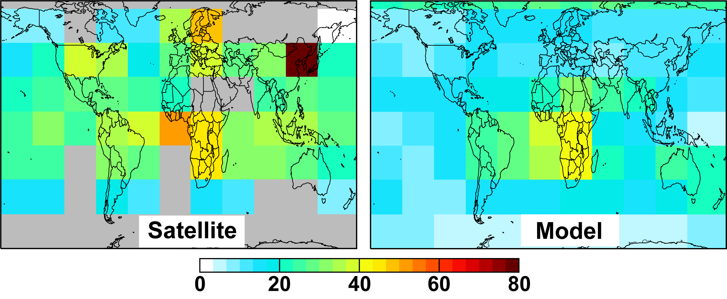
Errors in the Upper Troposphere Permeate the Whole Atmosphere
Small uncertainties in reactive nitrogen (NO_{y}) induce large climate and air quality errors
Model NO₂ too low across the UT in the northern midlatitudes
efficient ozone production
Errors in tropospheric ozone radiative forcing
satellite NO₂ retrievals
Uncertain global air quality constraints from satellites
[pptv]
[Marais et al., 2018]
Tropospheric ozone and methane have near-equal climate impacts
ozone
[IPCC AR5, 2013]
-1 0 1 2 3
Radiative Forcing [W m⁻²]

Slide 6
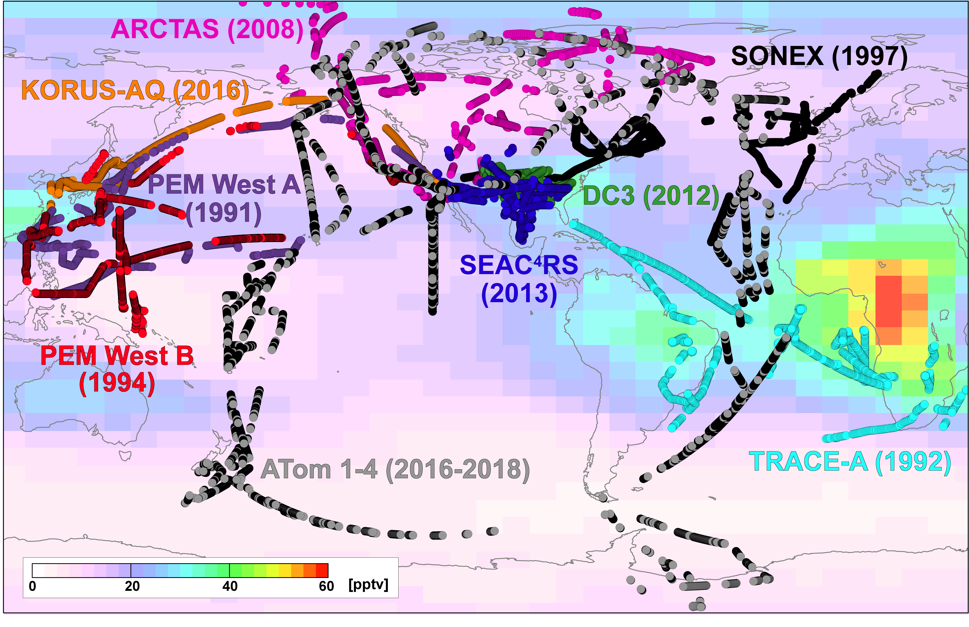
UpTrop will develop the first global observational dataset
Circles:
DC8
Background:
TROPOMI
(synthetic model output)

Slide 7
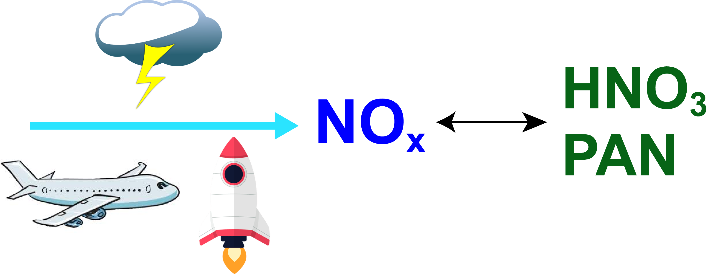
UpTrop will redefine our global understanding of ...
Air pollution sources and trends
Climate effect of tropospheric ozone
Air quality and climate impact of future NO_{x}
Persistence of pollutants and potent GHGs
Ozone abundance in the lower stratosphere

Slide 8
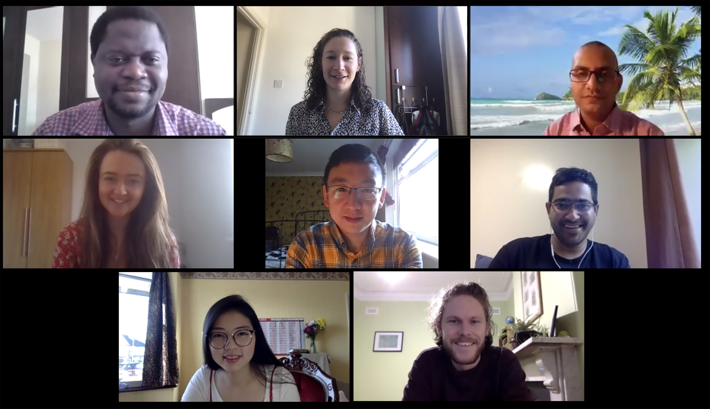
Leading an international research group
Alfred (PhD), Alok (postdoc), Chloe (visiting UG), Gongda (PhD), Karn (PhD), Nana (PhD), Rob (postdoc)

Slide 9
Working in an international research community
Opportunities:
See dynamic ways others …
approach research
fund research and manage research grants
collaborate
promote open access in publishing and data sharing
work toward addressing issues in research (biases, diversity, predatory journals)
consider ethical issues (choosing co-authors, using indigenous knowledge)
Challenges:
Funding opportunities don’t always cross political borders. Often requires in-kind contribution from international collaborators. Those that do cross borders (bilateral UK-US agreements, for example) can be double the work.
Hostile borders
Logistical challenges: harder to travel in Africa than travel to Europe or the US
Brexit. Don’t really know how devastating this will be for science in the UK. Might lost out on EU students and collaborating with EU researchers.

Slide 10
A few tips and pointers for applying for an ERC
This is not exhaustive!
Dream big, be ambitious, be bold (risky, but feasible)
Idea must be disruptive and make a substantial advancement on scientific knowledge
Must demonstrate the value of the research once it’s done
Start early, edit often
Meet with researchers you trust to give you honest, critical and constructive feedback
Meet with a range of researchers
Meet with research support division
Get lots of critical feedback from a range of specialists
Build up your research portfolio
Demonstrate research independence from your PhD supervisor
Work toward an impactful publication record
For more general tips and pointers on writing competitive grant and fellowship proposals: http://maraisresearchgroup.co.uk/Presentations/ProposalWriting.pdf

