Slide 1
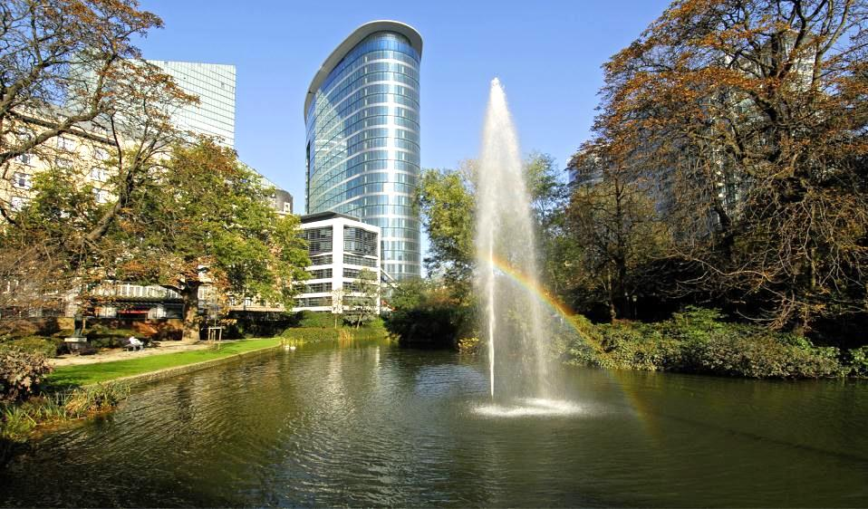
Funding Frontier Research:
the ERC Success Story
Jean-Pierre BOURGUIGNON
ERC President
© Art & Build Architect / Montois Partners / credits: S. Brison
November 2020

Slide 2


European Commission and the ERC
)
Directorate-General
Research and
Innovation (RTD)

Slide 3
The ERC: an Ambition for Science in Europe
Mission: To raise the level, dynamism and creativity of the whole European research system by:
Supporting the emergence of research leaders;
Improving the career prospects of early stage researchers;
Providing a benchmark for all of Europe’s national research authorities and individual institutions.

Slide 4
The ERC Governance and Strategy
Scientific Governance
Independent Scientific Council with 22 members including the ERC President with full authority over funding strategy and evaluation
Support by a Dedicated Implementation Structure (ERC Executive Agency)
Scientific Freedom
Scientific quality as the only criterion for selection
Support to the individual scientist – no consortia!
No predetermined subjects (bottom-up)
Support to Frontier Research in all fields of Science and Humanities
International peer-review

Slide 5
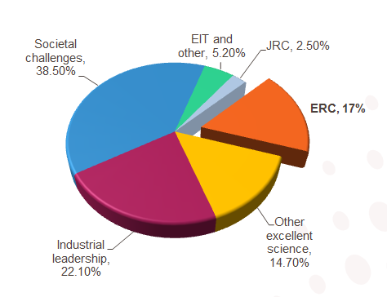
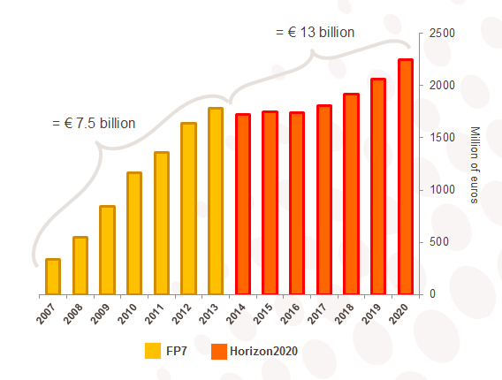
ERC Budget
Horizon 2020 budget distribution
ERC budget per year

Slide 6
ERC Grant Schemes
Starting Grants
starters
(2-7 years after PhD) up to € 1.5 Mio
for 5 years
Consolidator Grants
consolidators
(7-12 years after PhD) up to € 2 Mio
for 5 years
Advanced Grants
track-record of
significant research
achievements in the
last 10 years
up to € 2.5 Mio
for 5 years
Proof-of-Concept
bridging gap between research - earliest stage of marketable innovation
lump sum €150,000 for ERC grant holders
Synergy Grants (re-launched 2018)
2 – 4 Principal Investigators
up to € 10.0 Mio for 6 years
1 PI can be based outside EU/AC

Slide 7
After More than 10 Years, a Success Story
10,000
180,000
> 800
75,000
€ 13 billion
84

Slide 8
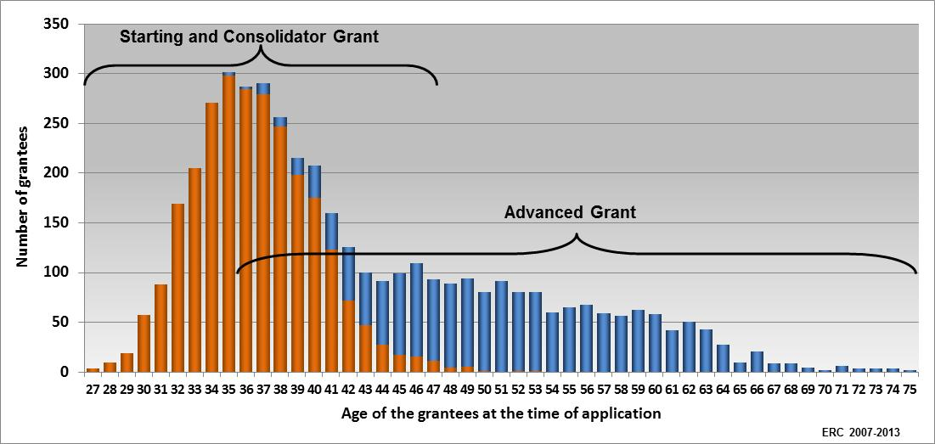
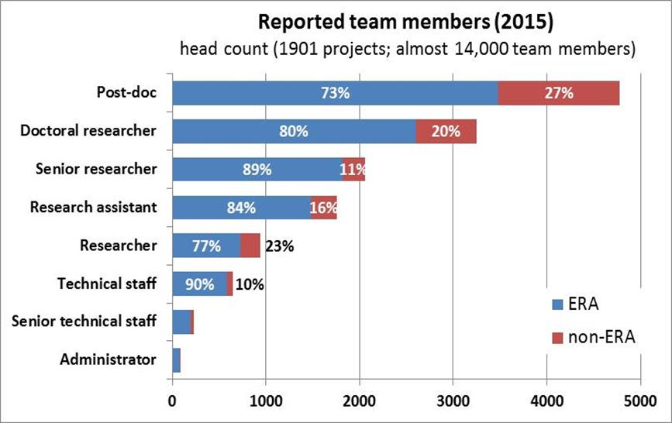
Priority to Young Scientists
> 45 000 PhD and post-doc researchers working in ERC teams
Two-thirds of ERC grants to early-stage
Principal Investigators

Slide 9
ERC Ex-post Evaluations
20% of ERC-funded Projects Deliver Scientific Breakthroughs

Slide 10
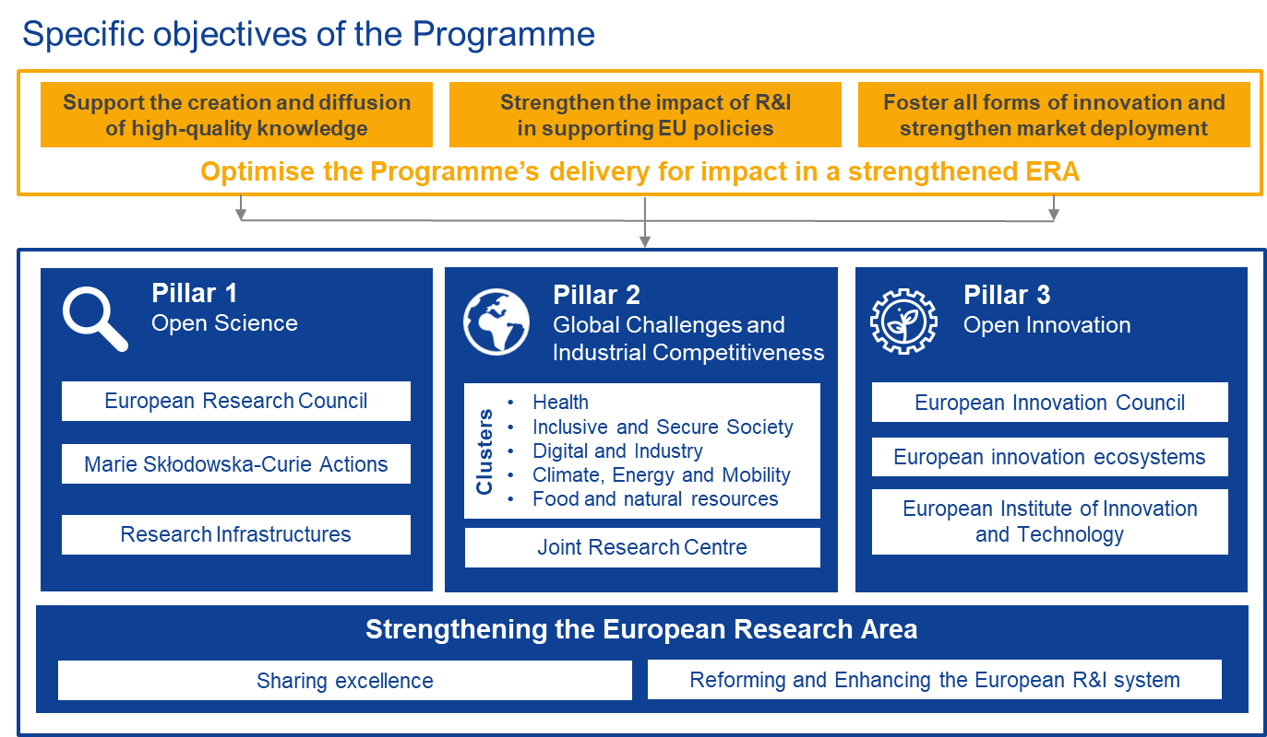
Horizon Europe: Evolution not Revolution

Slide 11
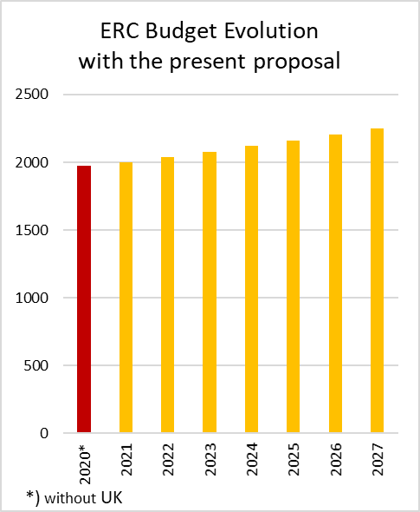
Possible ERC Budget Evolution
The ERC Budget Evolution
with the present proposal giving €14.86bn to the ERC in current prices, forces a freeze over the next 7 years with only inflation increases.
the ERC Scientific Council requests an absolute minimum budget of €16.6bn in current prices (or €14.7bn in constant 2018 prices) over the next 7 years

Slide 12
International Participation to the ERC

Slide 13
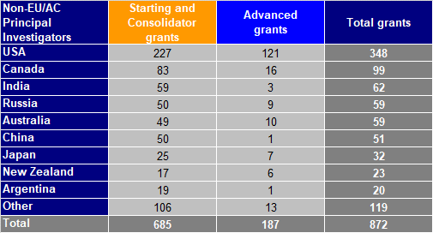
47 Non-EU/AC Nationalities
Over 8% of all ERC grants to principal investigators of non-EU/AC nationality
Only 16 grantees nationals of African countries:
5 South Africa
3 Morocco
3 Egypt
2 Algeria
1 Tunisia
1 Jordan
1 Cameroon

Slide 14
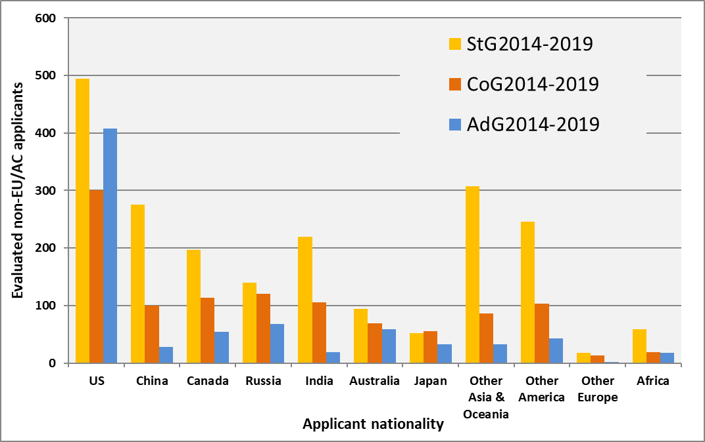
Proposals from non-EU/AC Nationals
Notes:
Most proposals from US/China nationals and in Starting Grant calls.

Slide 15
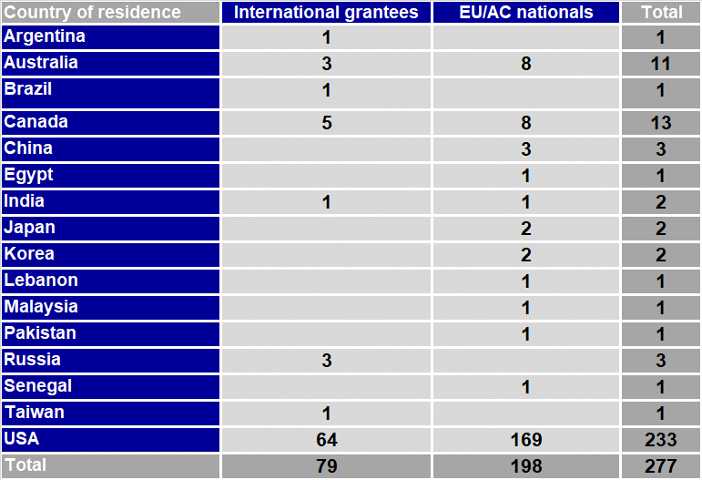
Grantees outside EU/AC at Application
Mainly European researchers moving/returning from the US
Note: ERC grantees residing outside EU/AC at the time of application

Slide 16
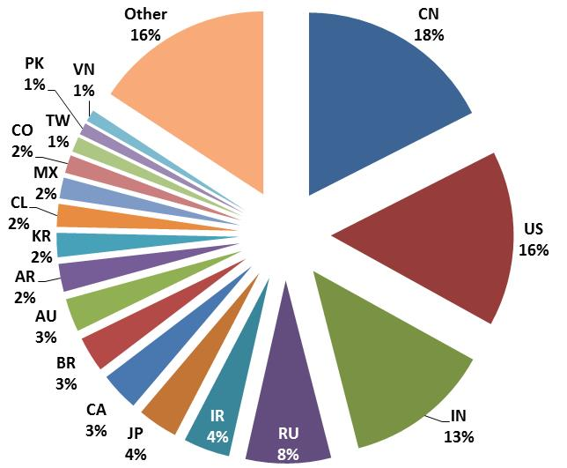
Attracting Researchers to Europe
Nationality of ERC project teams (PIs not included)
Analysis of 1,901 Starting and Advanced Grants
EU: 71%
Assoc. Countries: 10%
non-EU/AC: 17%
unknown: 2%
In all ERC grants
over 10,000 non-ERA team members
most from
China, US, India, and Russia

Slide 17
Implementing Arrangements
Opportunity for non-European researchers supported by foreign agencies to visit ERC research teams (unilateral approach)
The foreign researchers are supposed to be excellent ("national version" of the ERC grantee)
The foreign scientist is the one taking the initiative in the "matchmaking" (it is not the ERC/the ERC PI/the foreign agency…).
The ERC does not intervene in the selection of the foreign visitors and the ERC grantee covers the local costs with his or her grant.
Implementing arrangements signed with the following countries:
USA
Republic of Korea
Argentina
China
Japan
South Africa
Mexico
Brazil
Canada
India
Australia
Singapore
│ 17

Slide 18
Implementing Arrangement South Africa
Signed on October 2015 with the South Africa National Research Foundation
Opportunities for NRF grantees to temporarily join ERC teams
Results 2015-2019 period:
* 1728 ERC PIs expressed interest in hosting researchers from South Africa;
* 10 scientists of South Africa visited ERC projects.

Slide 19



The European Research Council
More information: erc.europa.eu
National Contact Point: erc.europa.eu/national-contact-points
Sign up for news alerts: erc.europa.eu/keep-updated-erc
Follow us on
www.facebook.com/EuropeanResearchCouncil
twitter.com/ERC_Research
www.linkedin.com/company/european-research-council

