Slide 1


Mustapha Laatiaoui
Johannes Gutenberg University, Mainz
November 10th, 2020
EUROPEAN RESEARCH COUNCIL WEBINAR
FOR RESEARCHERS IN AFRIKA
Grantees’ experience

Slide 2

Brief CV
43; born & raised in Morocco
Came to Germany with 16
High School in Dortmund
Studied Physics (BSc+MSc) at TUM in Munich
2010 PhD, LMU Munich
2010-2016 Postdoc GSI Helmholtz Center, Darmstadt
2017 Postdoc, KU Leuven (Belgium)
2018 Senior Researcher, JGU Mainz
2019 Junior Research Group leader and lecturer, JGU
Expand Horizons
New Collaborations
New Ideas
Mobility

Slide 3

The Project
Excellent idea
“Laser Resonance Chromatography
of Superheavy Metals”
    High-risk/high-gain
    Feasible

Slide 4
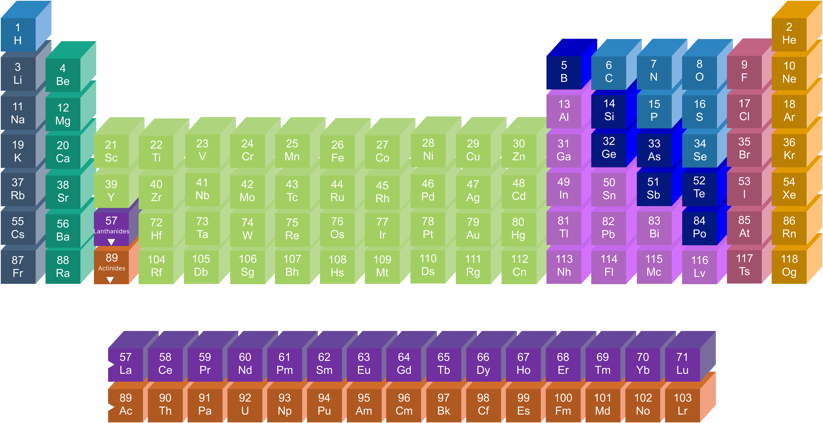
The superheavy elements
What is the heaviest element that can exist?
What chemical, atomic & nuclear properties do SuperHeavy Elements (SHEs) have?
How robust are atomic & nuclear structure models in the region of the SHEs?
Are these elements being produced in the universe?

Slide 5
The superheavy elements
Superheavy elements:
  Short lived (max. a few seconds)
  Extremely low production yields
  (1/s – 1/week)
  Only basic nuclear properties are known (e.g. decay modes)

Slide 6
Objectives
Explore the atomic structure (Theo. & Exp.) of superheavy transition metals starting with lawrencium (element 103, ²⁵⁵Lr)
Delineate optical spectral lines for the search for SHEs in the universe
Generate powerful benchmarks for state-of-the-art atomic modeling
Extract nuclear properties of SHEs independent of nuclear models

Slide 7
State-of-the-art

Slide 8
State-of-the-art
Atomic experimental data completely missing
  High-accuracy atomic modeling &
  Extremely-sensitive experiments (one-atom-at-a-time) required

Slide 9
State-of-the-art
Atomic experimental data completely missing
  High-accuracy atomic modeling &
  Extremely-sensitive experiments (one-atom-at-a-time) required
Laatiaoui et al., Nature, 538:495 (2016)
Z=102

Slide 10
State-of-the-art
Atomic experimental data completely missing
  High-accuracy atomic modeling &
  Extremely-sensitive experiments (one-atom-at-a-time) required
Laatiaoui et al., Nature, 538:495 (2016)
Z=102
Continuum
Continuum
hν
???
hν
Fluorescence detection
Resonance ionization

Slide 11
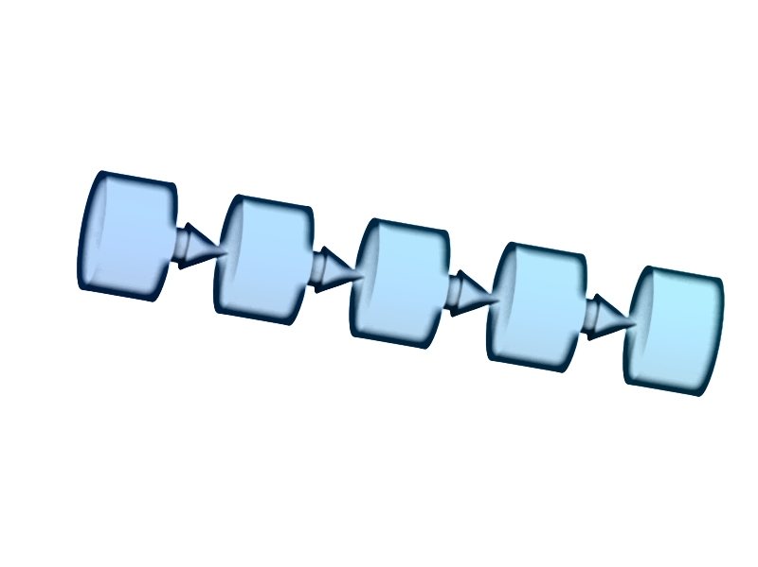
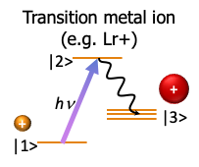
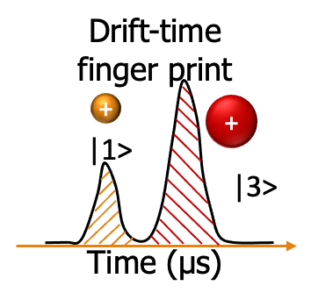
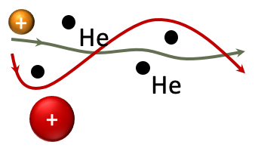
The innovative LRC concept
Production
separation
Slowing
down
Laser
probing
Ion
isolation
ions ions ions ions
Detection

Slide 12
The innovative LRC concept
Some general features:
    Fast (milliseconds)
  → No additional preparation stages
  (e.g. neutralization/evaporation of sample atoms)
    Sensitive
  → No need for fluorescence detection
  → No need for photoionization
    Universal
  → Insensitive to physicochemical properties
    Versatile
  → Broadband initial level search
→ Precision HFS
Continuum
|2>
hν
|3>
|1>

Slide 13
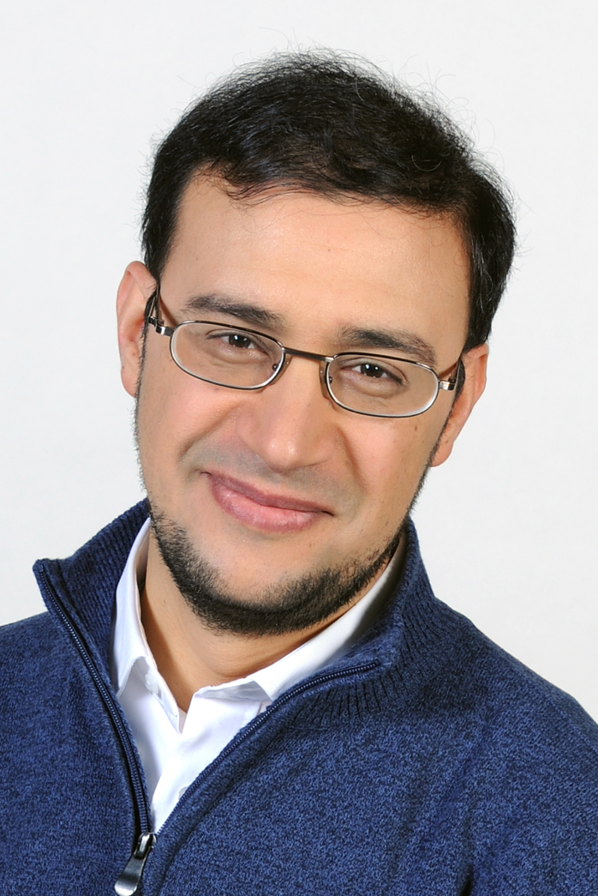




Team & network
PI
Elisa R.
Postdoc (Exp.)
Theo.
University of Groningen U. New South Wales, Sydney
Skolkovo Institute, Moscow
Harry R.
Postdoc (Theo.)
Kim E.
PhD (Exp.)
Exp.
Maier-Leibnitz Lab
Institute for Nuclear Chemistry University of Munich
& Institute for Nuclear Physics
University of Mainz Institute for Applied Physics
TU Darmstadt
Institute for Nuclear & Radiation Physics
KU Leuven
Germany
France

Slide 14
ERC Grant Application
June 2017 Idea formulated (KUL/Be)
July 2017 Calculations/simulations
October 2017 Started writing
February 2018 ERC-CoG application
Mai 2018 First step results
September 2018 Interview in Brussels
November 2018 Acceptance notification
January 2019 Grant Agreement signed
June 2019 Project start

Slide 15
Few words to writing
B1 + B2
Lots of proofreading
  → vers.#10 submitted
Commitment of host institution needed
Requested 2 MEur
→ team & equipment (5 years)

Slide 16
Content
Exciting topic (attracting attention)
Demonstrate excellence
Concise (short and to the point)
„Atomic spectra consisting of discrete lines of different color … have been key ingredients in understanding the cosmic origin of matter. Currently however, optical spectroscopy ends at nobelium (element 102, No) [1]. I propose …“
[1] M. Laatiaoui et al., Nature 538 (2016) 495.

Slide 17
Interview
(12 + ~8) minutes for PE2 panel
→ No technical details!
Interview training for German interviewees @European Liaison Office of the German Research Organizations
Practiced my talk ~40 times
(myself + in front of colleagues)
Prepared for general audience
15 panel members (+feedback from 6 reviewers)
Easy questions (scientific + implementation)

Slide 18
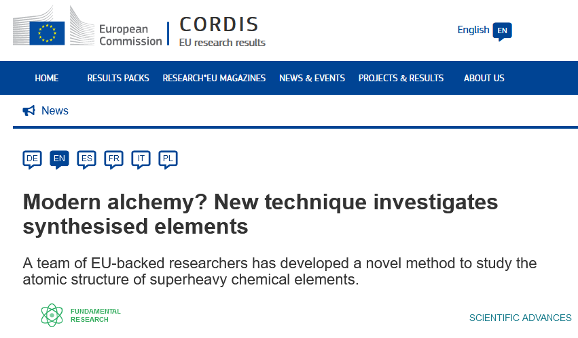
First LRC results

Slide 19
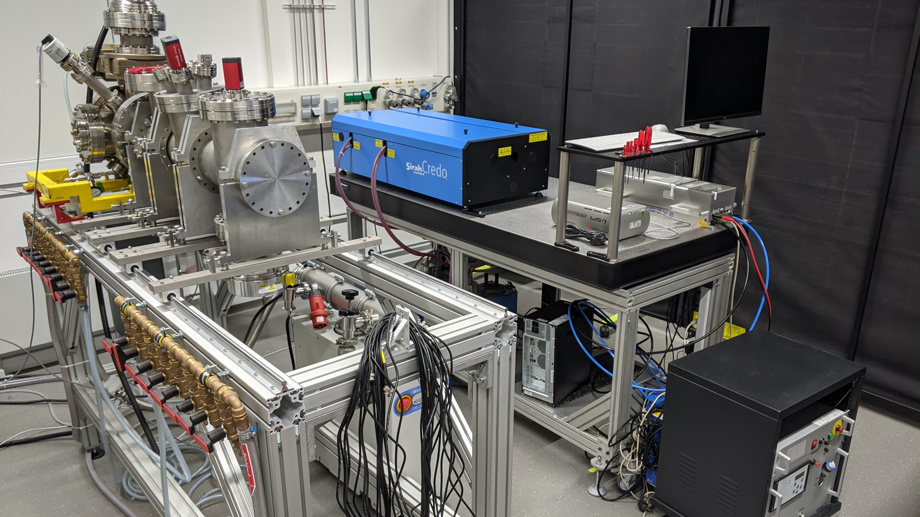
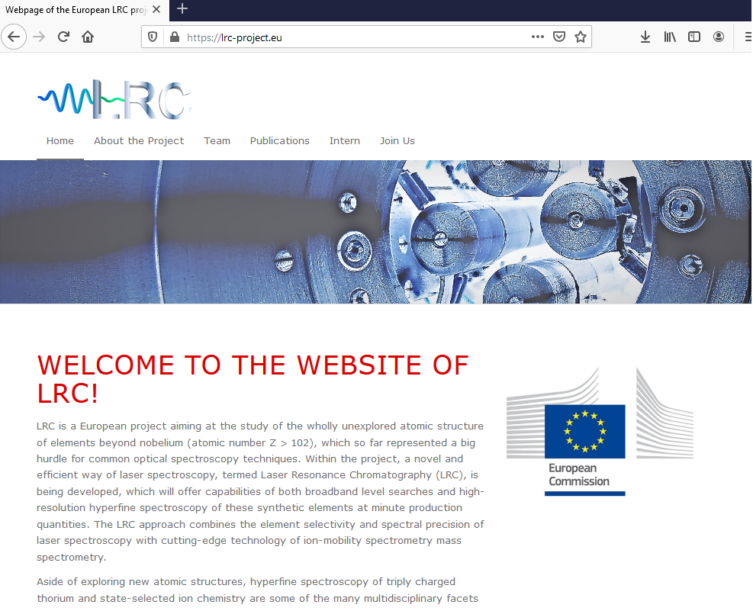
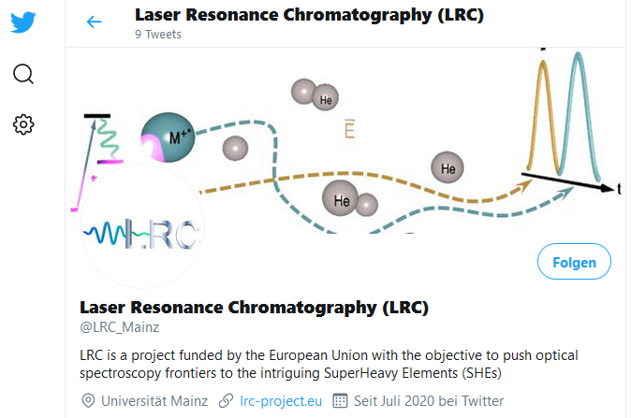
Thank you!
The lab
www.lrc-project.eu
twitter.com/LRC_Mainz

